Slide 1
Amazon Sales Analysis
By:
Bhargav Kanneti --AP21110010204
Puneet Sai Sadanala--AP21110010256
Aditya Sai Ungati --AP21110011049

Slide 2
01
Abstract
02
Introduction
03
Work flow of project
04
System Requirements
Contents
05
Visualisation
06
Key Insights
07
Suggestions
08
Conclusion

Slide 3
Abstract
The primary objective of this data analysis project is to gain a
comprehensive understanding of Amazon’s sales performance, customer behavior, and
market trends. By analyzing historical sales data, we aim to answer critical questions that
can help businesses and stakeholders harness Amazon’s potential and achieve better
outcomes in the competitive e-commerce landscape.

Slide 4
Introduction
In recent years, e-commerce has experienced explosive growth, with Amazon being one of the leading players in the global online retail market. As a result, analyzing Amazon sales data has become increasingly crucial for businesses and analysts seeking to understand consumer behavior, market trends, and overall performance.
In this analysis, we collected a data set of amazon sales record from the internet. The variables of interest include product names, types, sizes, place of delivery, and cost of the product.
We applied statistical and data visualization techniques to interpret the findings effectively using matplotlib, seaborn, pandas and NumPy.

Slide 5


System Requirements
Software:
Excel (for the CSV data)
Jupyter Notebook (for analysing and visualising)
Hardware:
Processor(cpu) – Inter Core i3 and above
Memory – 8 GB RAM and above
Storage – 256 GB internal storage drive

Slide 6
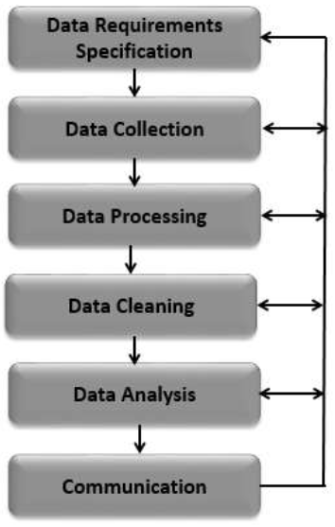
Work Flow of Project
Reading the dataset
Applying basic functions
Data Cleaning
Data Filtering
Grouping the data
Sorting the data
Aggregations(min, max, mean, mode, variance)
Data Visualization
Observations and Conclusion

Slide 7
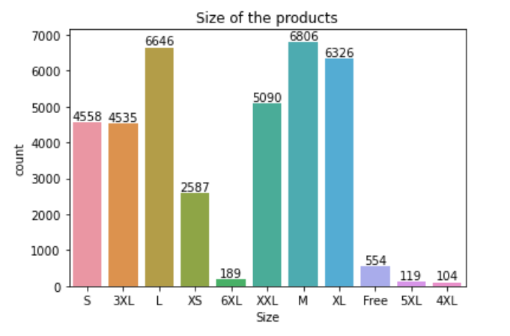
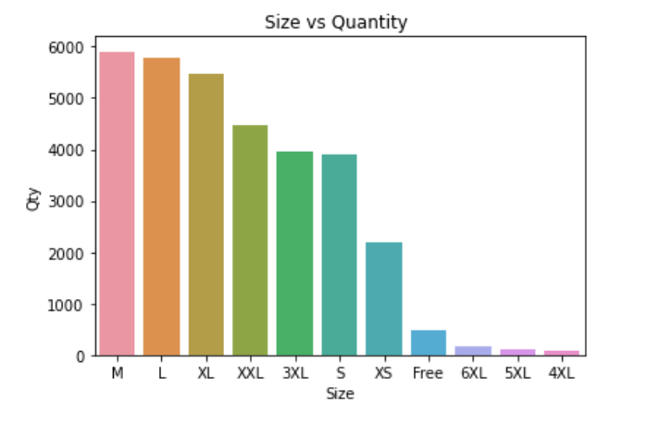
Visualization of data

Slide 8
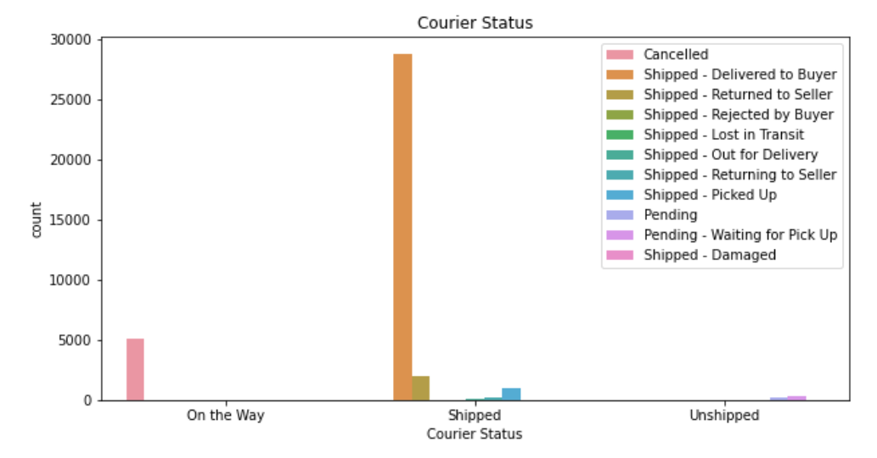
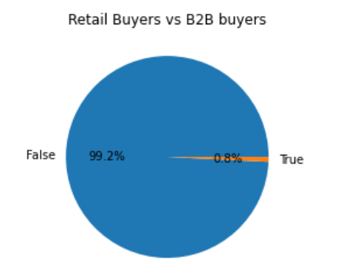
Visualization of data

Slide 9
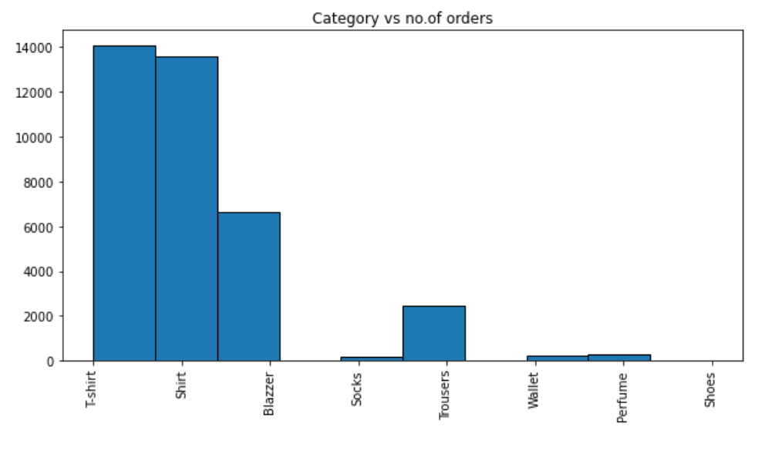
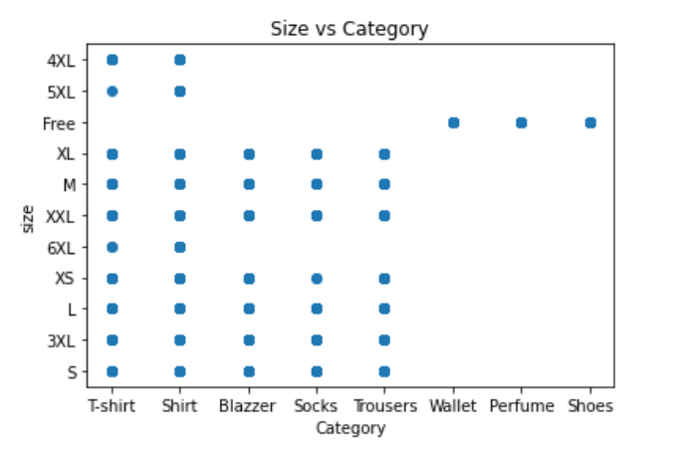
Visualization of data

Slide 10
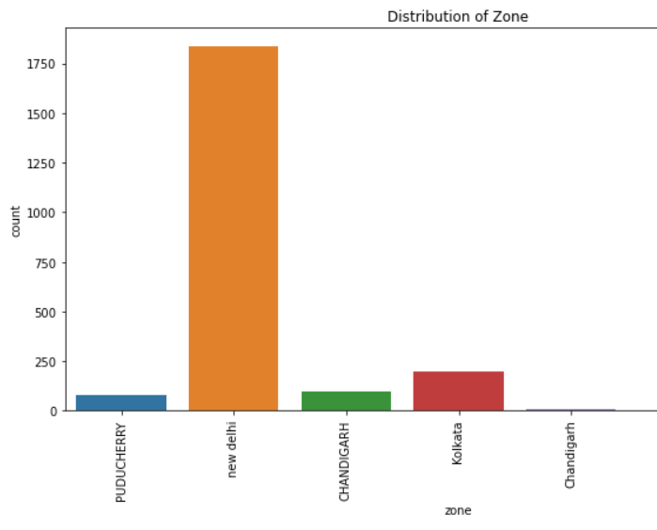
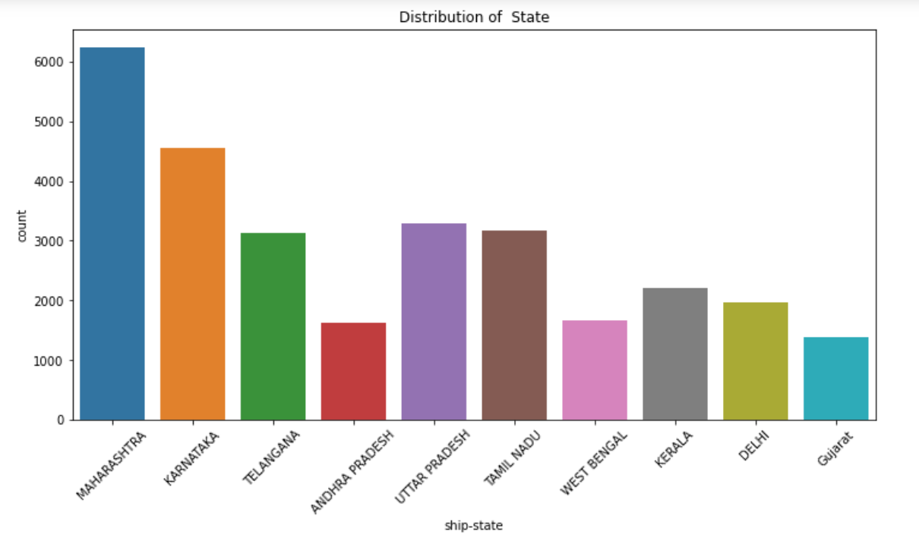
Visualization of data

Slide 11

Key Insights
Some of the key insights we understood from visualized data are:
Most of the people buy M-sized products.
Majority of the orders are shipped through the courier , and only few orders are cancelled.
T-shirts are the most bought products.
Maximum i.e.99.2% of buyers are retailers and 0.8% are B2B buyers.
T-Shirts and Shirts are available in every size , whereas blazers, socks and trousers are available only until XL size.
People in New Delhi order more products.
Most of the customers are from Maharashtra state.

Slide 12
Suggestions
Based on this analysis, Amazon should try to implement the below aspects:
Since most of the orders are from Maharashtra and Delhi, amazon should try to increase their distribution partners in these areas so that they can deliver the products without any inconvenience.
They should try to increase T-shirt production before they get out of stock.
Marketing team of the company should focus more on the least ordered products and zones and continuously follow the latest trends which are in high demand but less production.
Company should try to address problems which lead to cancellation of the orders by taking feedback from the customers.

Slide 13
Conclusion
By conducting a thorough analysis of the dataset, we aim to provide valuable insights into industry dynamics, choices of the people in the market, and current trends in the market and also where to invest more to get more income according to the interest of the customers.
The project’s findings would be very valuable for investors policy makers, and marketing committees to find a better strategy to get profit in the sales market for the company and also make decisions related to amount of number of quantities to be produced to get the profits.

Slide 14
Thank you

